Slide 1
SMART LIGHTING
Prepared by:
Jinto Jose
Manoj Reddy Dumpa
Venkata Praneeth Mummaneni

Slide 2
Internet of Things(IoT) is being used widely these days to take care of the home automation applications such as smart lighting, smart heaters, smart air conditioners, smart Televisions etc.
IoT services are affordable
It is much easier to interact with these applications/appliances
Remote access is also possible
Introduction

Slide 3
Smart Lighting application using AWS IoT and Raspberry-Pi
Control LED light using button as well as remotely through commands on a PC
Button presses as well as PC commands are synchronized through AWS IoT
Project Overview

Slide 4
Registered to AWS IoT
Connected the circuit
Wrote code in Python for the logic to be implemented on PC as well as Raspberry-Pi
Started the process
Procedure Overview

Slide 5
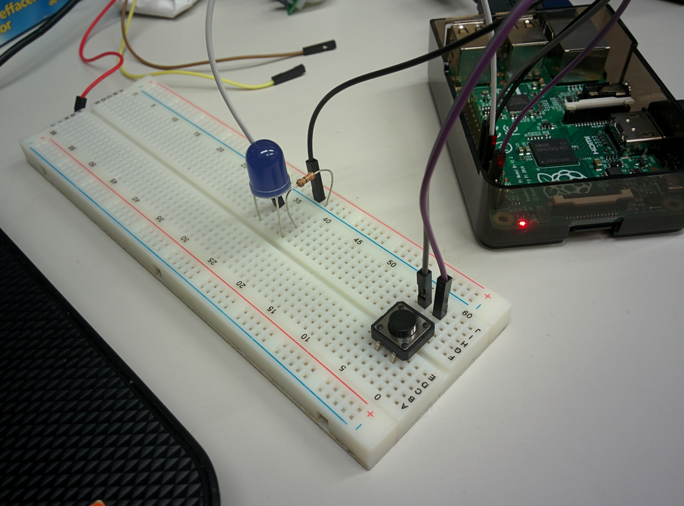
Circuit Connections

Slide 6
Created an AWS account
Registered the thing
Procedure

Slide 7
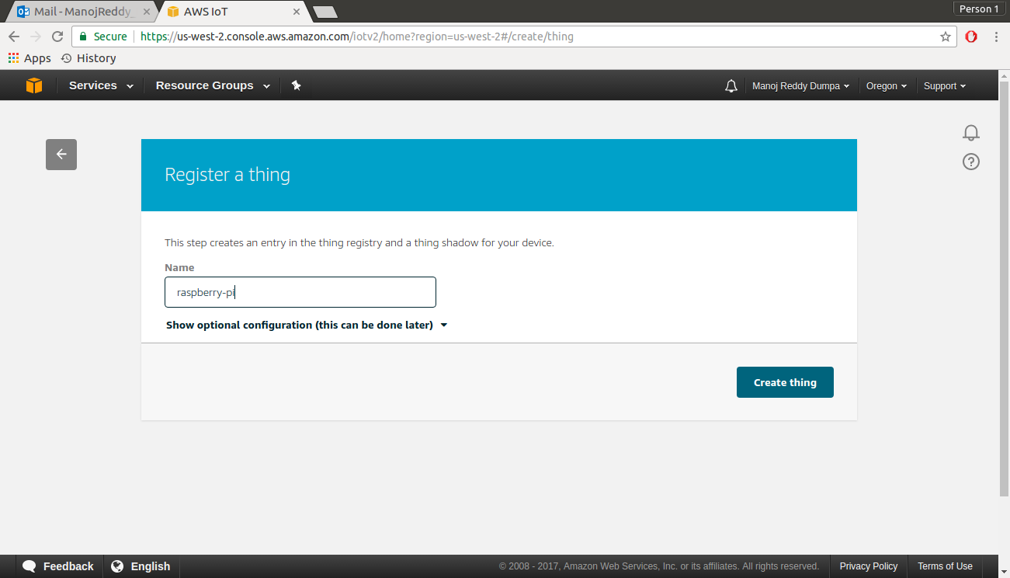

Slide 8
Created a certificate which automatically generates a certificate, public key and private key
Activated the certificate, public and private keys
Procedure (contd.)

Slide 9
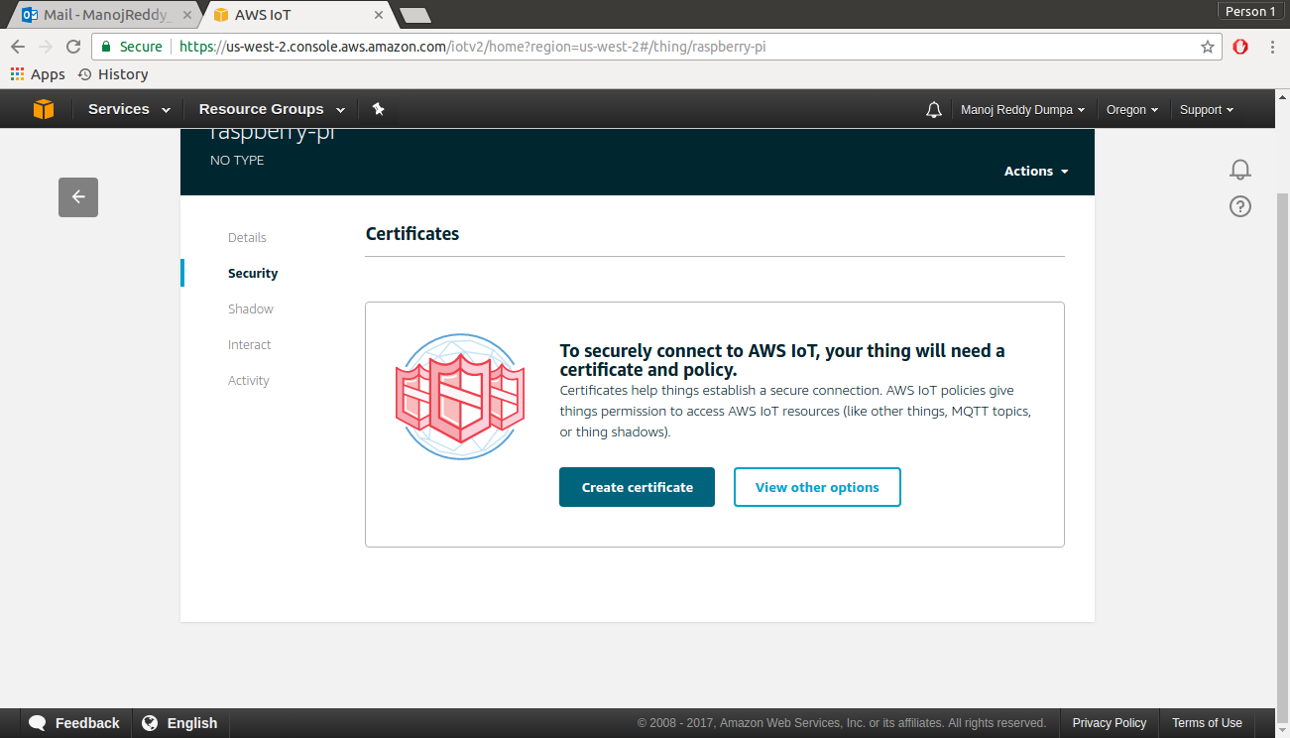

Slide 10
Created a policy
Attached the policy to the certificate
Attached the thing to the certificate
Procedure (contd.)

Slide 11
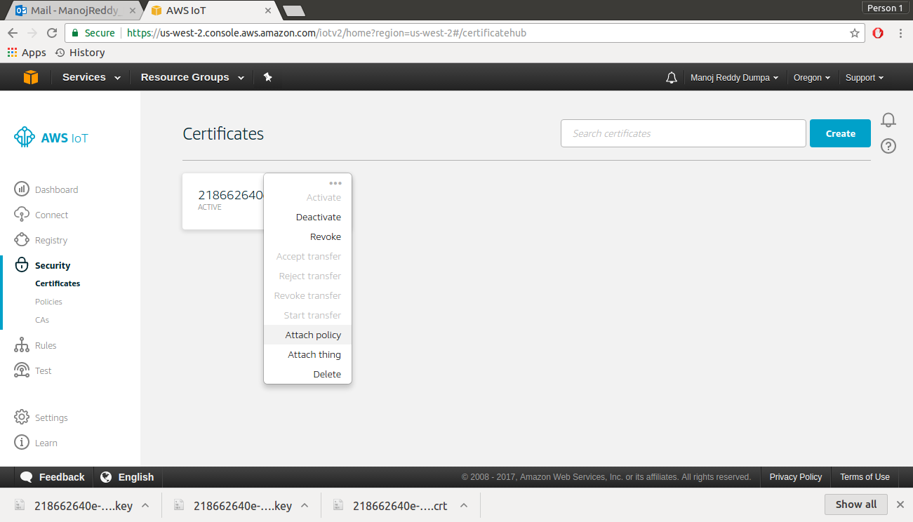

Slide 12
paho-mqtt was installed on the Raspberry-Pi as well as on PC
simplejson was also installed
Procedure (contd.)

Slide 13
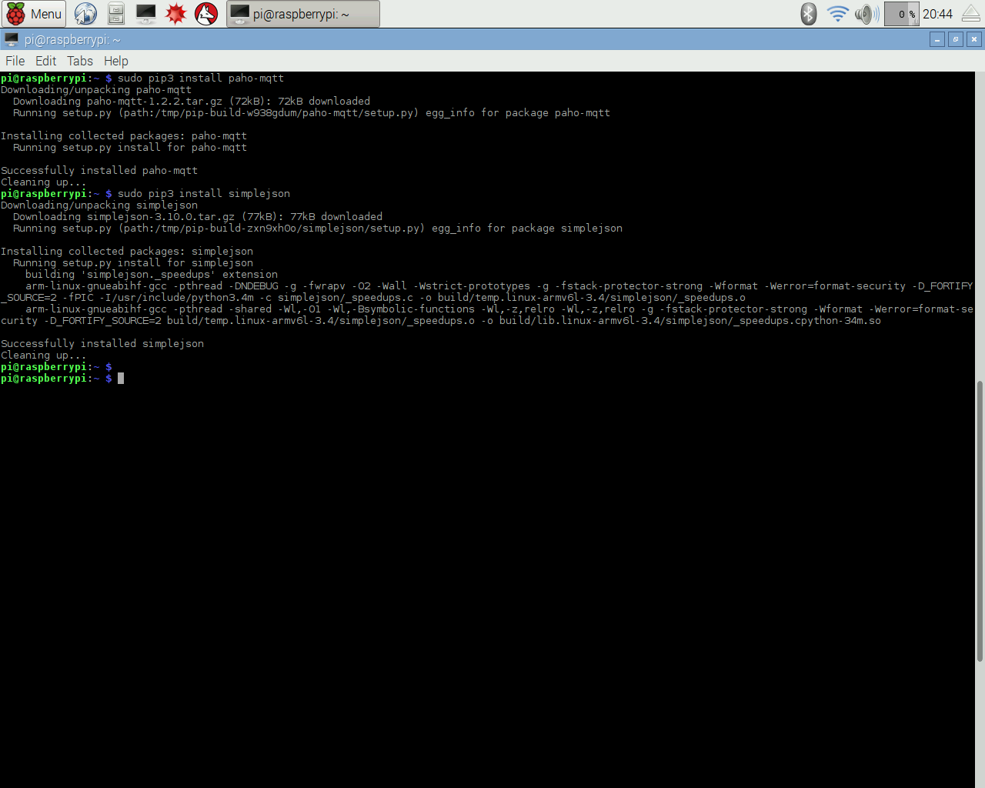

Slide 14
Created a rule in AWS IoT to extract led state from a particular topic and store it in dynamoDB
Procedure (contd.)

Slide 15
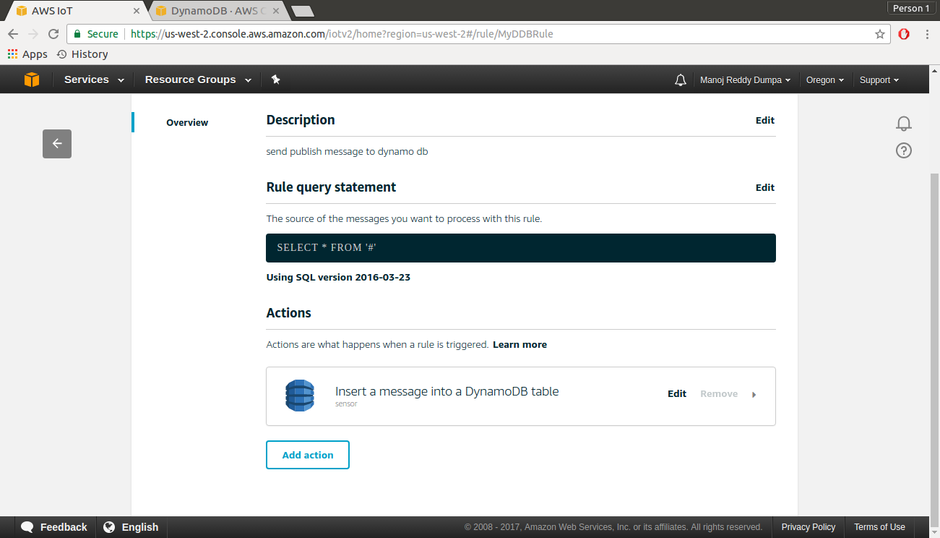

Slide 16
Python code was written for the button LED combination for Raspberry-pi as well as for remote PC.
Procedure (contd.)

Slide 17
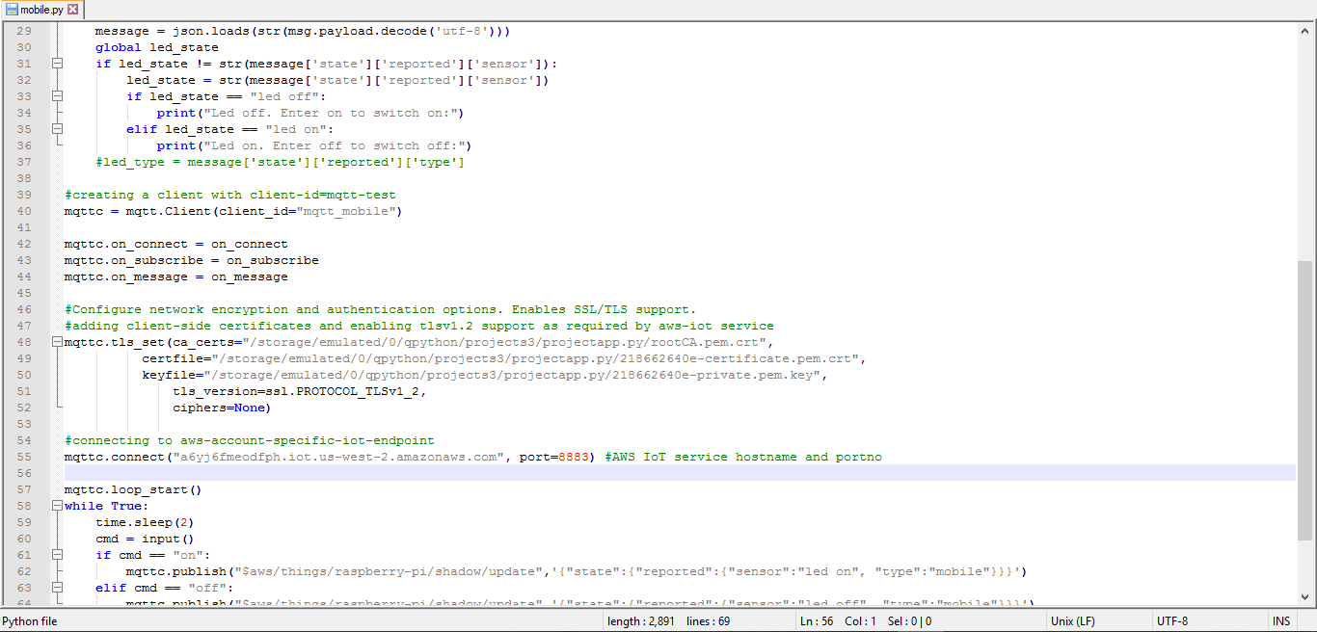
SAMPLE CODE

Slide 18
The python code was run on PC and Raspberry-Pi
It was made sure that both were subscribed to the same topic
Procedure (CONTD.)

Slide 19
Initial State of LED

Slide 20

Raspberry-Pi Console

Slide 21

Remote PC Console

Slide 22
When Button was pressed, the LED lit up
Procedure (CONTD.)

Slide 23
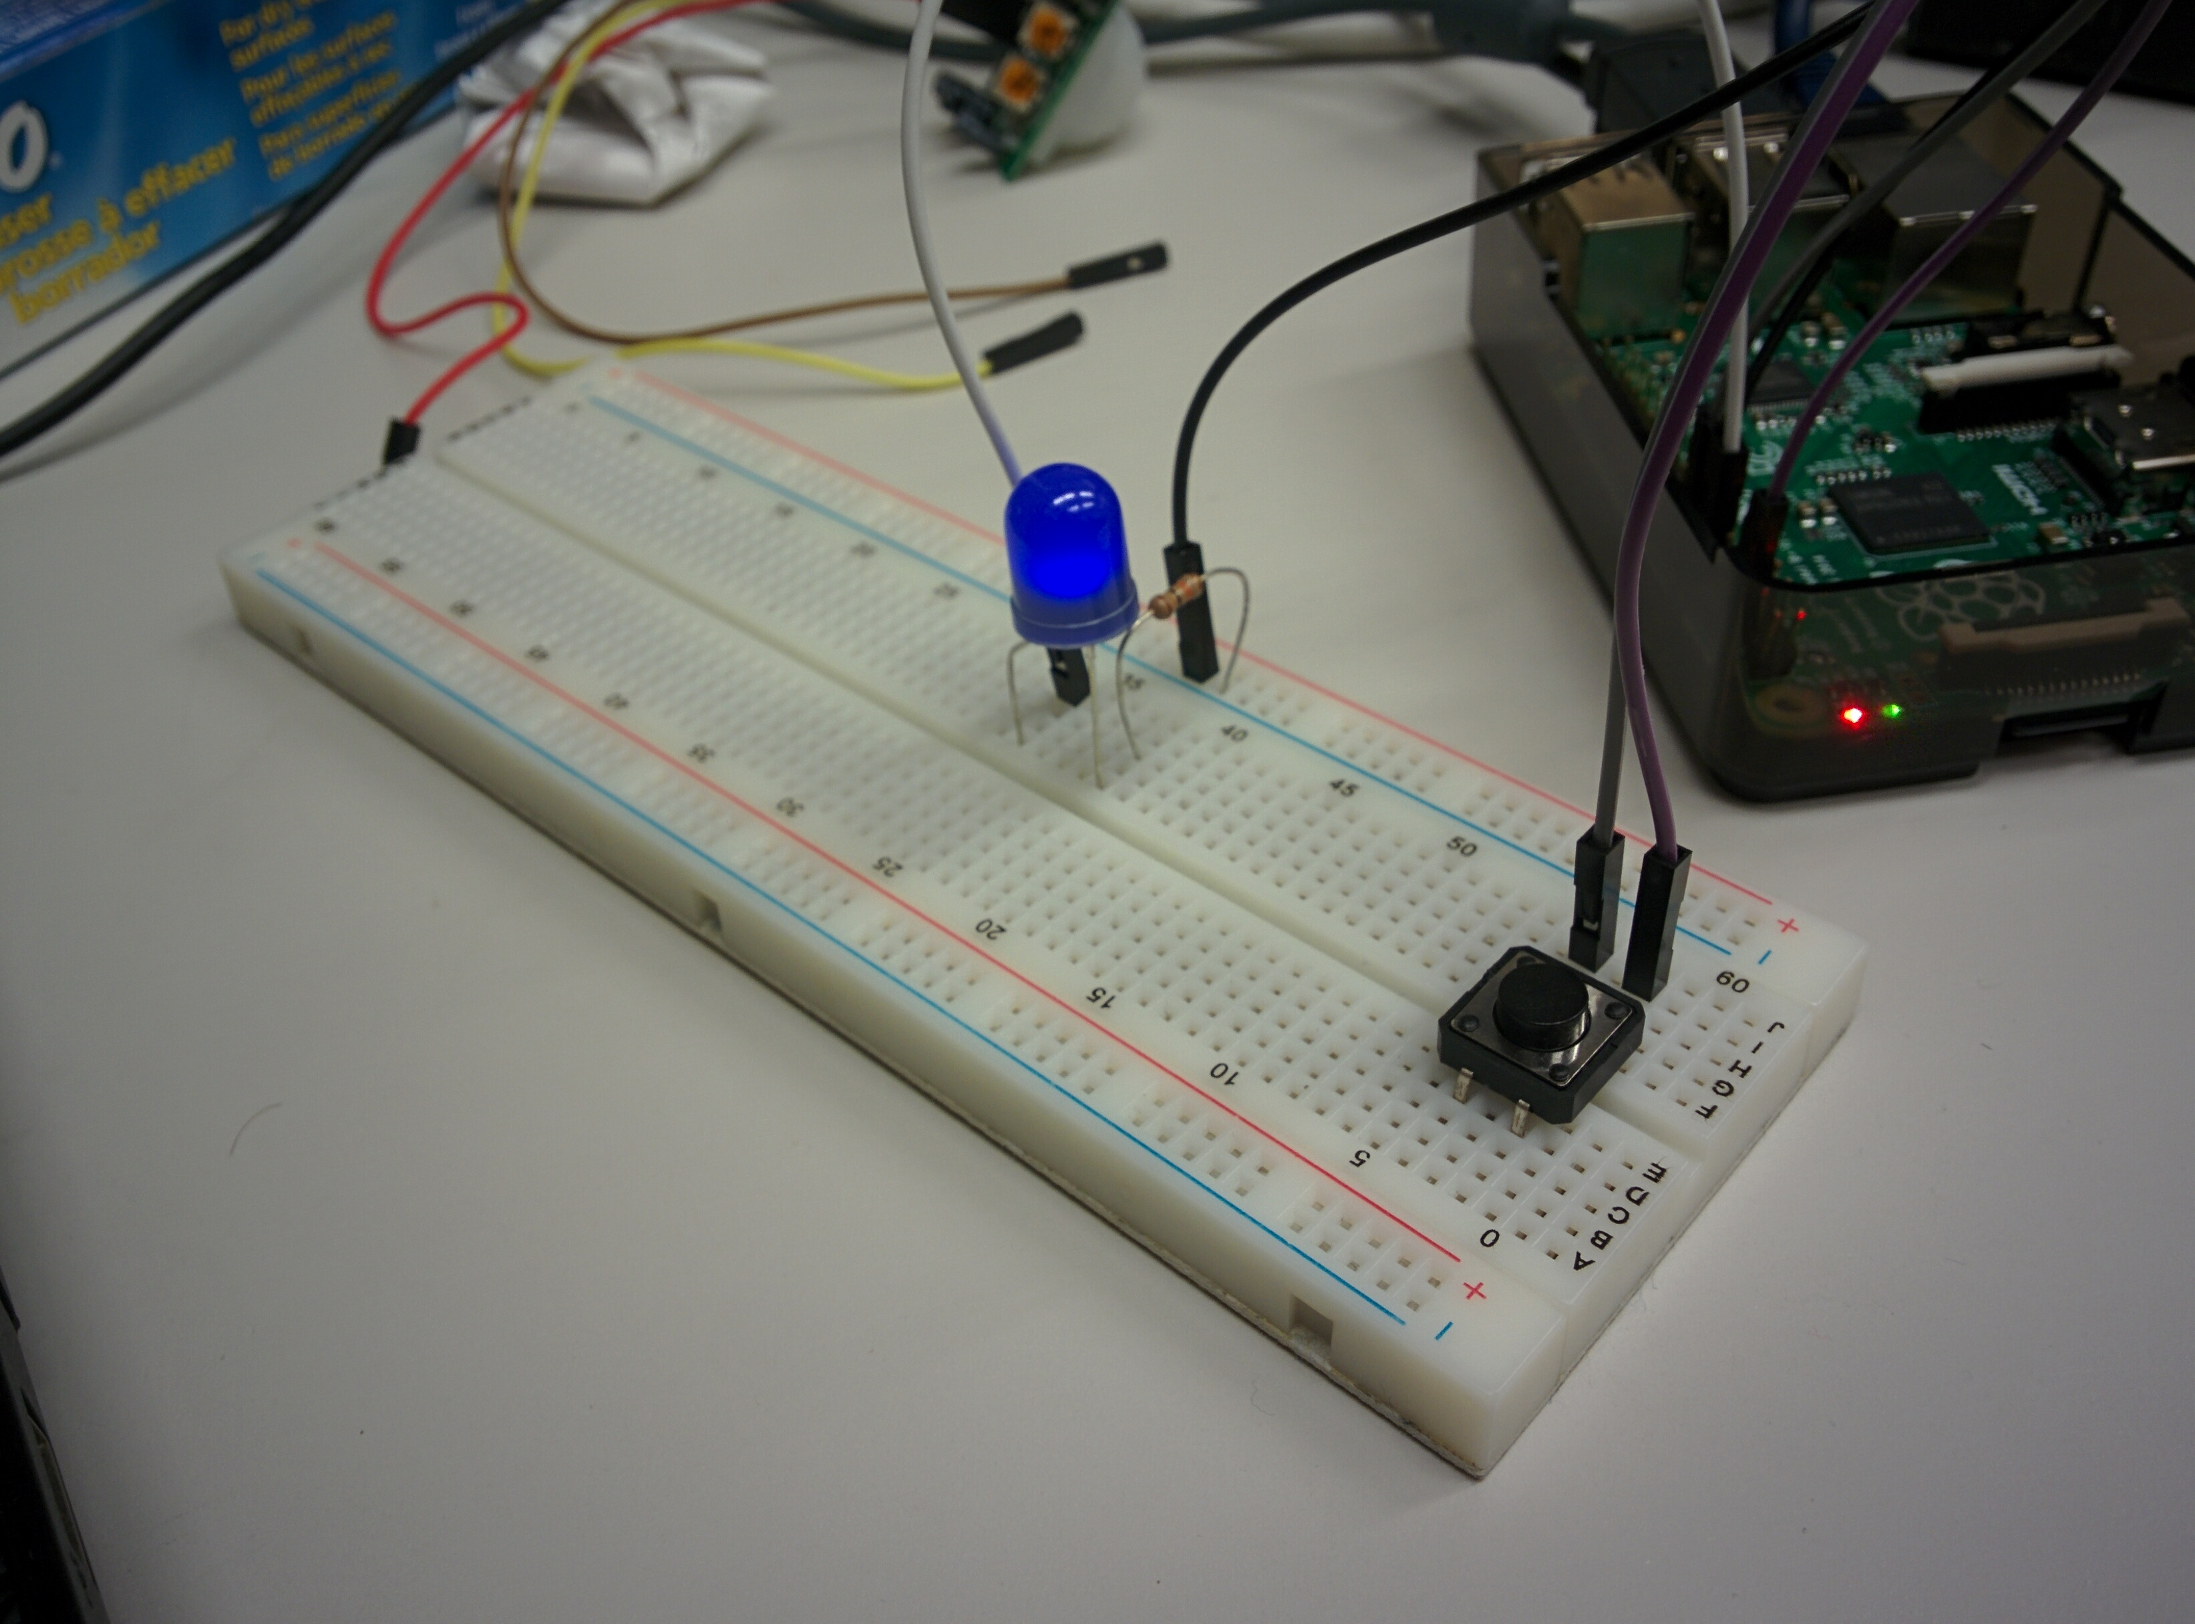

Slide 24
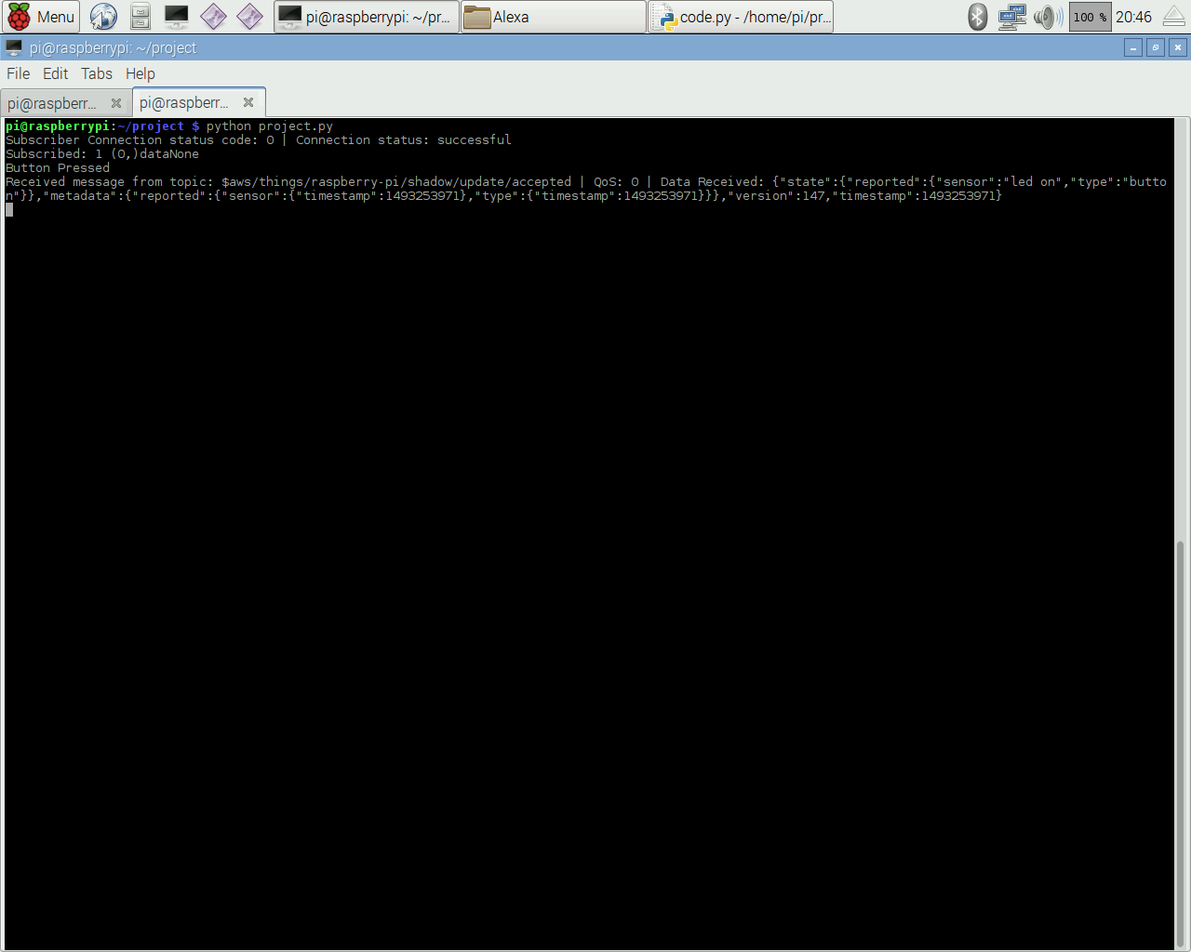

Slide 25


Slide 26
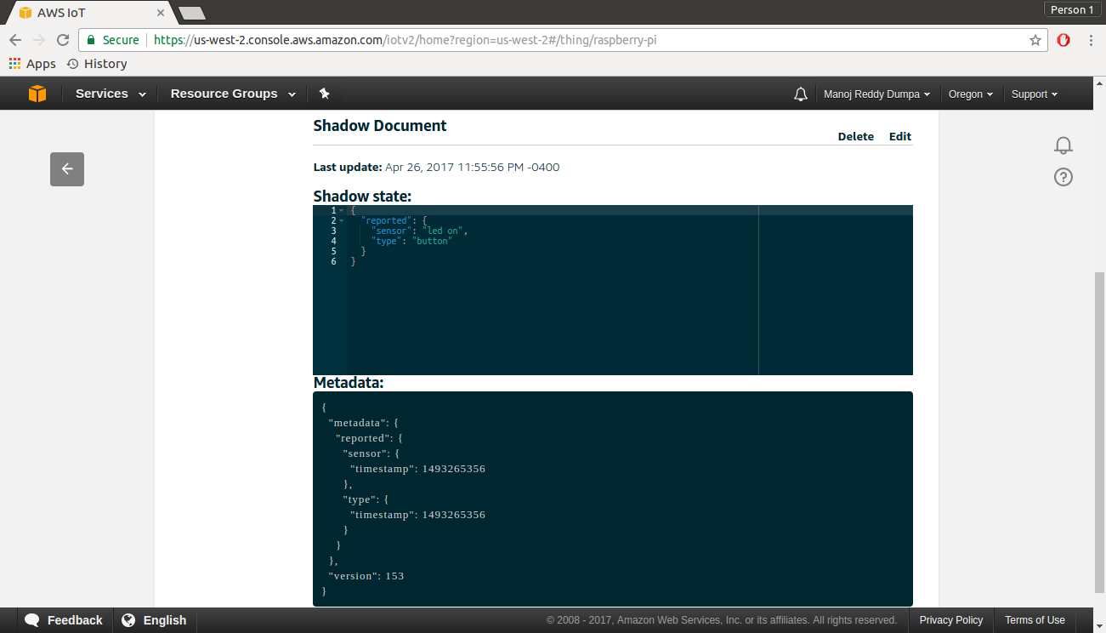

Slide 27
When the button was pressed again as the LED was on, it gets switched off
Procedure (CONTD.)

Slide 29


Slide 30
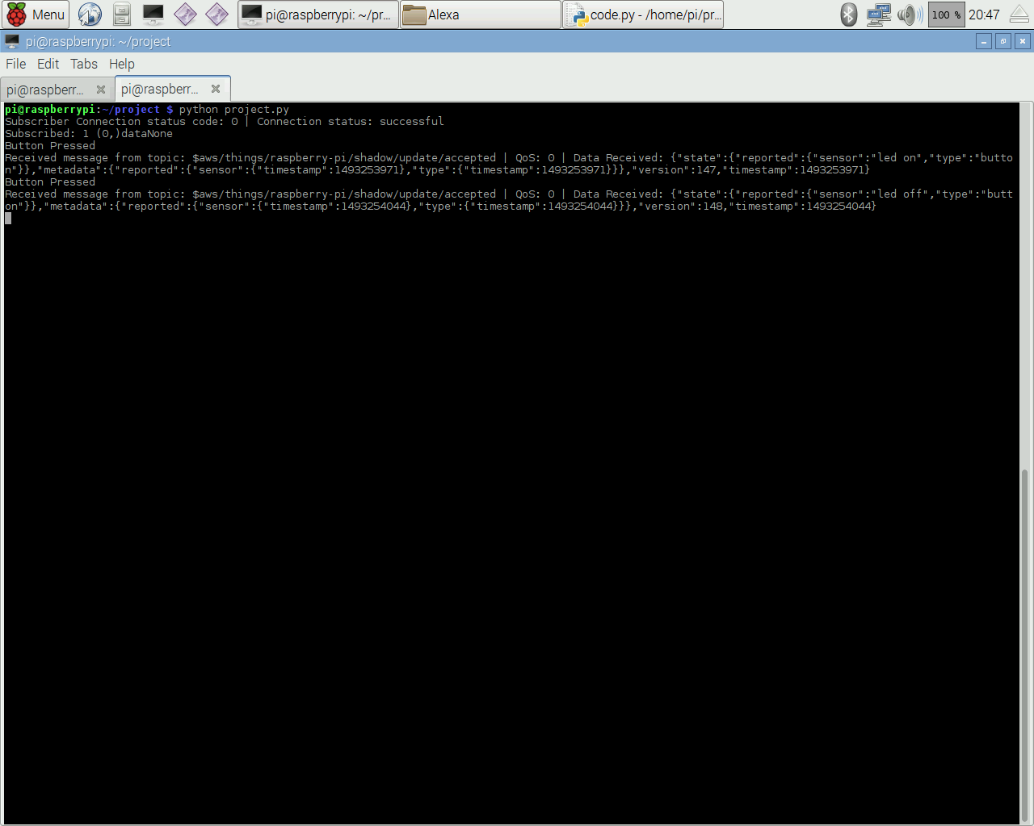

Slide 31


Slide 32
Now, according to the code, if the LED was off, keyword “on” was entered on the PC to switch on the LED
Procedure (CONTD.)

Slide 33


Slide 35
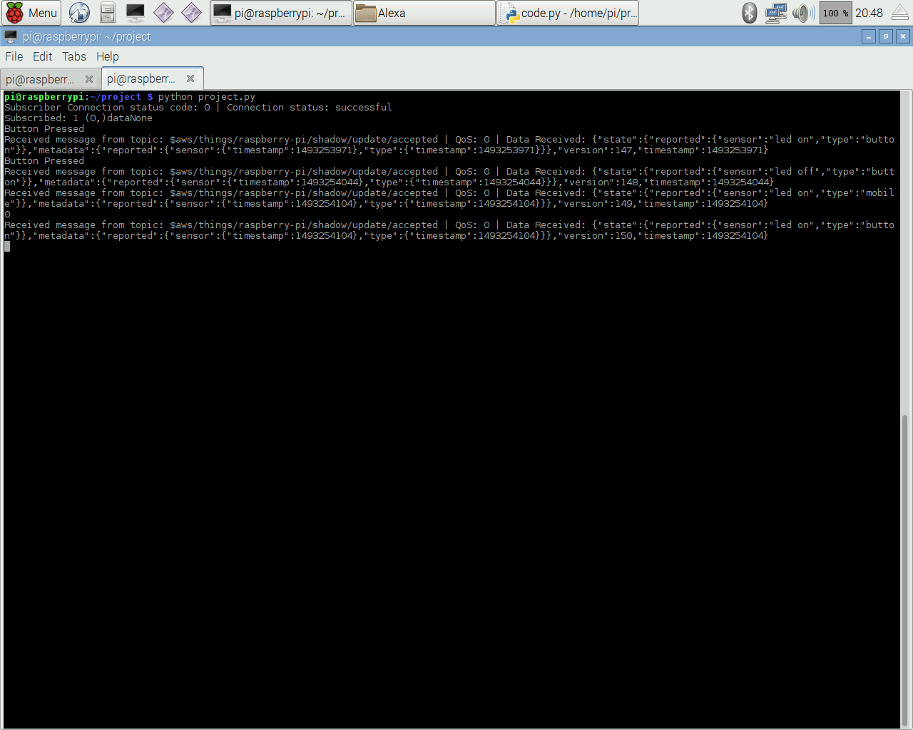

Slide 36


Slide 37
Now, according to the code, if the LED was on, keyword “off” was entered on the PC to switch on the LED
Procedure (CONTD.)

Slide 38


Slide 40
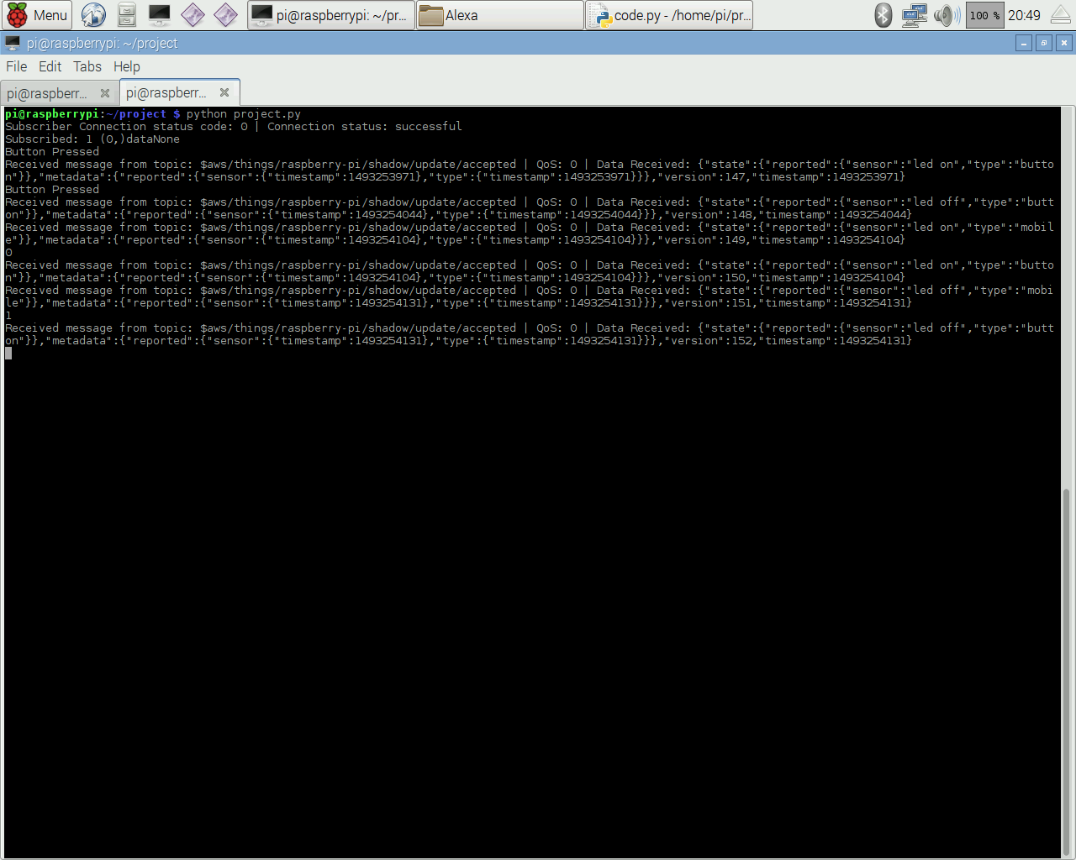

Slide 41


Slide 42
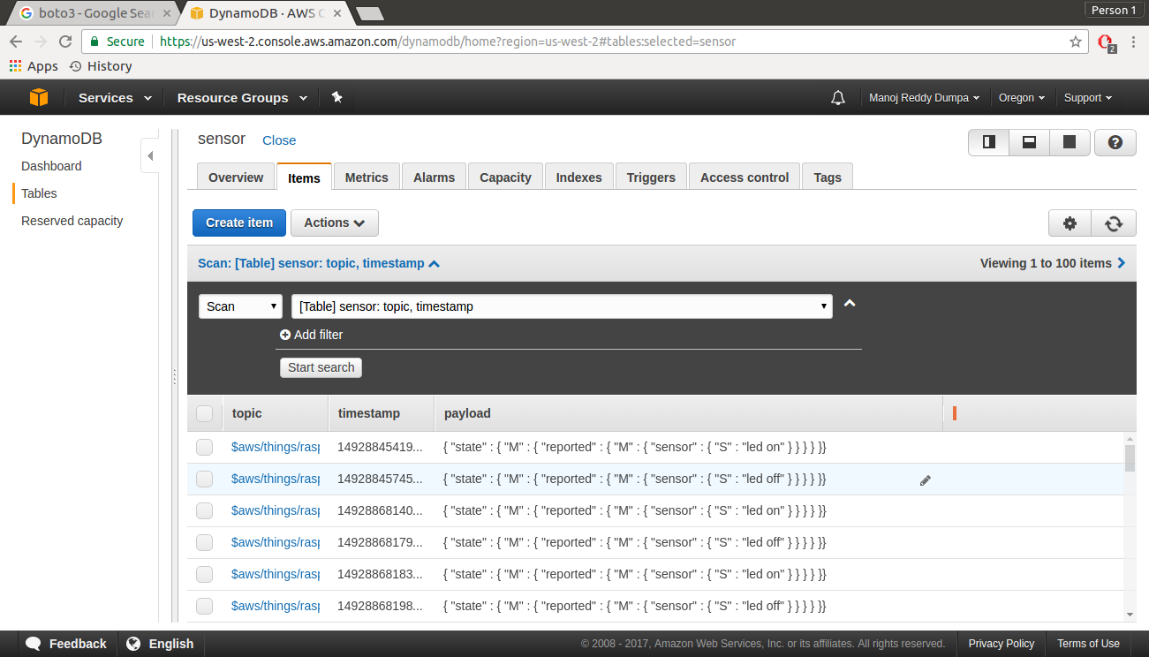
LED State data Stored in DynamoDB

Slide 43
We were able to create a synchronized system where the LED could be controlled remotely through a device i.e. PC as well as through physical means i.e. a button
CONCLUSION

Slide 44
QUESTIONS?

